Slide 1
Angular, Express , Node & MongoDB (MEAN) stack
Derese Getachew & Bsquare Technologies

Slide 2
Course Structure
REST (NodeJS, Express) & Mongoose
Build our backend API
Angular & Typescript
Build our front end for our project
Connect it with the service we built

Slide 3
What is MEAN Stack
MEAN stack is a number of frameworks and technologies working together to provide a full stack solution to the developer
At the front end we have Angular
At the back end we have Express and Nodejs to build our API’s, This can also be substituted by any Node JS framework like NestJS
MongoDB as our data Storage

Slide 4
Introduction to Typescript
Typescript
JavaScript
In order to build applications with angular , we need to be comfortable with Typescript.
Typescript is a superset of javascript. Any valid JS code is Valid TS Code.
Strong Typing
Object-oriented features
Compile-time errors
Great Tooling
Browsers do not understand Typescript so we have to transpile it to javascript

Slide 5
Install Typescript
Typescript
JavaScript
Assuming you have installed node and npm, run
npm install -g typescript
Next , to check if it was successfully installed run
tsc --version
Install ts-node
npm install -g ts-node
Go to our project folder you cloned earlier to ts_intro
run main.ts through typescript compile using ts-node main.ts

Slide 6
Types in Typescript
Some of the most common types defined by TS include
boolean
number
string
array
Enum
Sometimes when you know more about the value than Typescript does you can use type assertion to tell the compiler what type to use.
lastName = "abcd";
(lastName as string).endsWith("d");
(<string>lastName).endsWith('d');

Slide 7
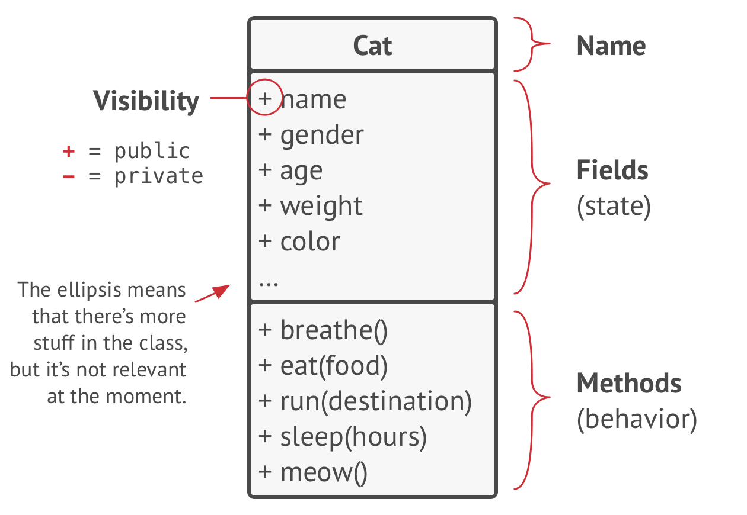
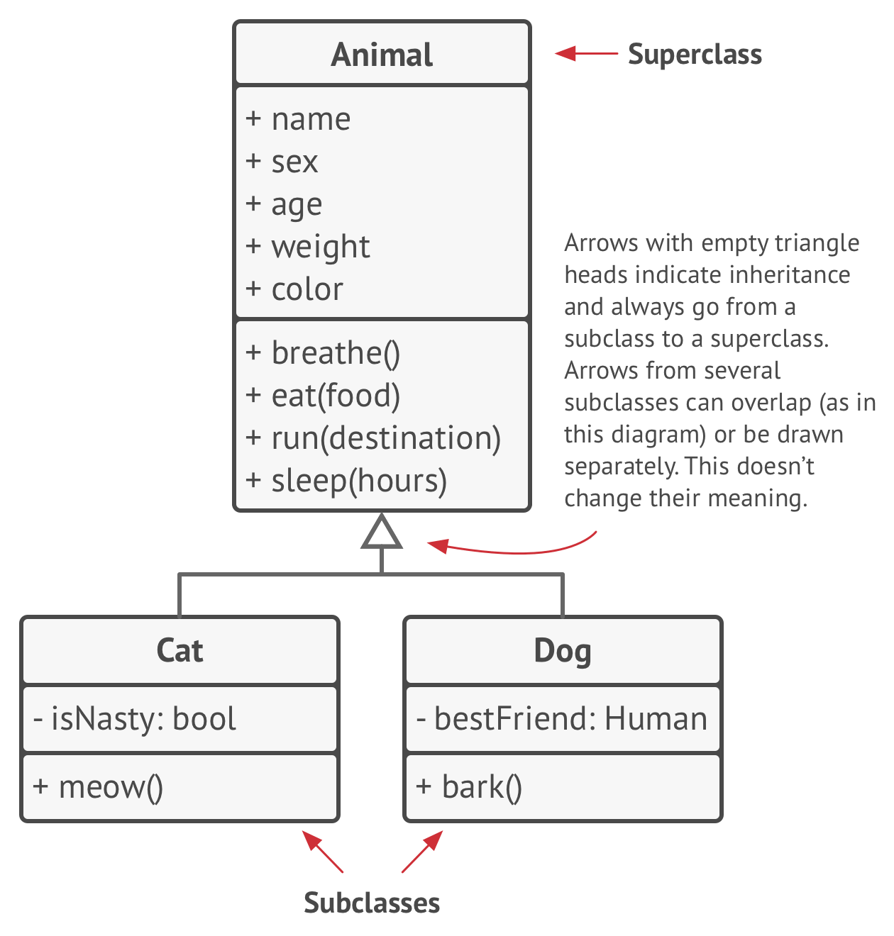
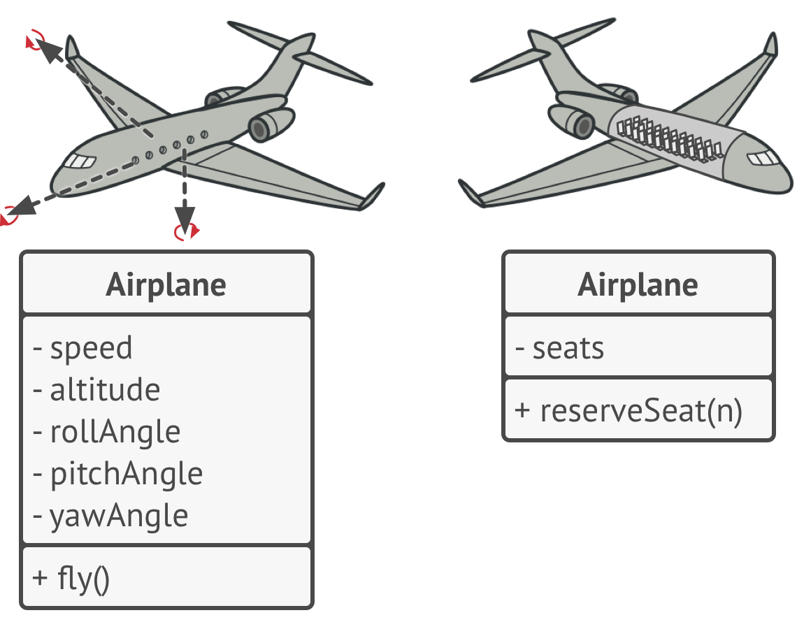
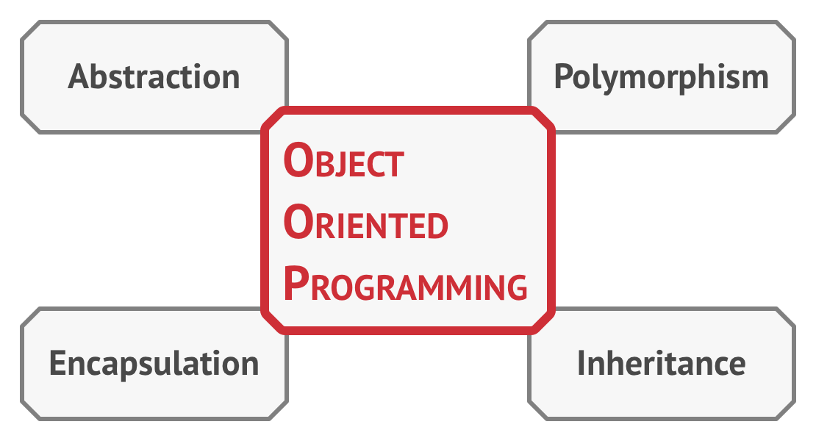
OO Programming & Typescript
We mentioned Object oriented features as benefits of typescript.
To Support OOP, Typescript gives us the concepts of Interfaces and Classes , Accessors among others to build our code in OO fashion.
OO Principles:
Classes are blueprints of objects that define the structure and behaviour of our objects.
Objects are instances of classes
Class hierarchies:
Super Class (parent class):
Sub Class : Inherits State and behavior from parent class, defining only attributes and behaviours that differ. Subclasses can override the behavior they inherit from parent classes.

Slide 8

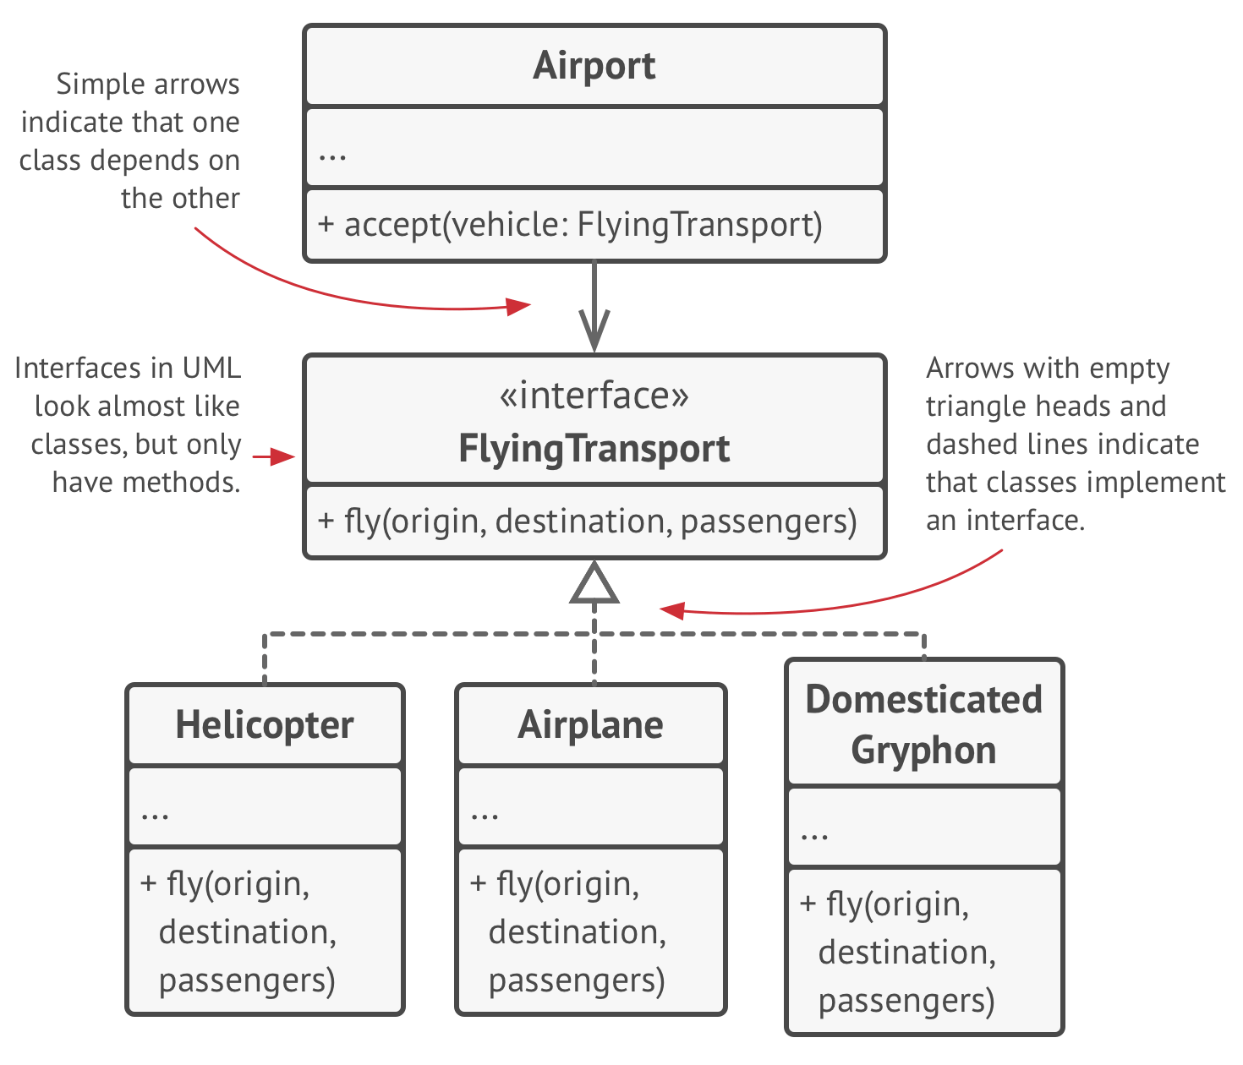
OO Programming & Typescript
Abstraction: model of a real world object or phenomenon limited to a specific context
Encapsulation : The ability of an object to hide parts of its state and behaviour from other objects , exposing only a limited interface to the rest of the program. E.g. a car tire.
Interfaces and abstract classes are based on the concepts of abstraction and encapsulation
Inheritance: the ability to ability to build new classes on top of existing ones. The main benefit of inheritance is code reuse.
Polymorphism: is the ability of a program to detect the real class of an object and call its implementation even when it’s real type in unknown in the current context. You can also think of it as the ability of an object to pretend to be something else, usually a class it extends or an interface it implements.

Slide 9
Interfaces, Classes in Typescript
One of TypeScript’s core principles is that type checking focuses on the shape that values have. This is sometimes called “duck typing” or “structural subtyping”.
In TypeScript, interfaces fill the role of naming these types, and are a powerful way of defining contracts within your code as well as contracts with code outside of your project.
Interfaces are used for declarations and not implementations.
Interfaces are capable of describing the wide range of shapes that JavaScript objects can take:
We can describe objects with properties using interfaces
We can describe functions using interfaces
We can describe indexable types using interfaces (indexable by number or string)
We can describe class Types using interfaces
Please refer to our code in projects/ts_intro for more.

Slide 10
Interfaces, Classes in Typescript
Interfaces can extends another interface definition
For example if we have a Person interface and a Child interface , child interface can extend the behaviour definitions of the person interface
Class implements interfaces;
From the above example any class implementing the Child interface has to also implement the behaviours definitions of a person interface.
Interfaces describe the public side of class
Typescript provides us with access modifiers :
public: default access modifier; makes prop, behaviours accessible outside of the object/class
private: restricts access to members of certain properties or behaviors of an object
protected: The protected modifier acts much like the private modifier with the exception that members declared protected can also be accessed within deriving classes

Slide 11
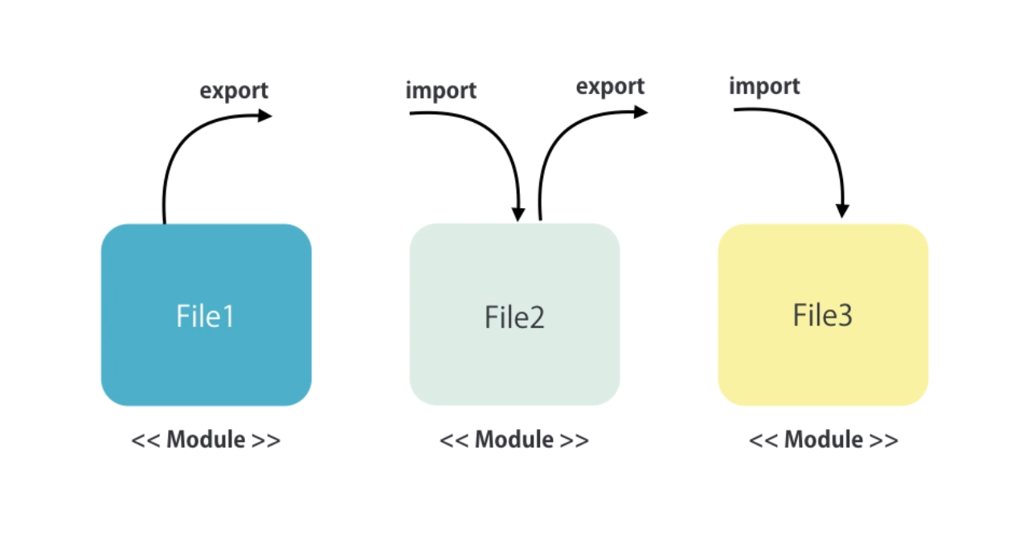
Modules in Typescript
Please refer to our code in projects/ts_intro/points.ts & module.ts for more.
In typescript we have a concept of Modules.
Each file can be thought of as a module, the file should have a class , variable , function that it is exporting.
To import a module we use the import keyword
So when it comes to importing types defined in Angular , we use the library name as the module name.
e.g. import {} from ‘@angular/core’.

Slide 12
Exercise
Imagine a simple counting app, it has two buttons + and - , when we press + it increments the count and when we - it decrements the count. The App can be turned on or off, when it is turned on its counter started from zero but you can also give it the starting number to when turning it on so that it can increment or decrement from that number
Define the counter class in a separate module and use it in the solution.ts file.

Slide 13
REST
REST, or REpresentational State Transfer, is an architectural style for providing standards between computer systems on the web, making it easier for systems to communicate with each other. REST-compliant systems, often called RESTful systems, are characterized by how they are stateless and separate the concerns of client and server.
Separation of client and server : In the REST architectural style, the implementation of the client and the implementation of the server can be done independently without each knowing about the other. This means that the code on the client side can be changed at any time without affecting the operation of the server, and the code on the server side can be changed without affecting the operation of the client.
As long as each side knows what format of messages to send to the other, they can be kept modular and separate. The separation allows each component the ability to evolve independently.By using a REST interface, different clients hit the same REST endpoints, perform the same actions, and receive the same responses.
Statelessness : Systems that follow the REST paradigm are stateless, meaning that the server does not need to know anything about what state the client is in and vice versa. In this way, both the server and the client can understand any message received, even without seeing previous messages.
Statelessness is infroced using resources rather than commands. Resources are the nouns of the Web - they describe any object, document, or thing that you may need to store or send to other services.

Slide 14
REST
Communication between client and server : In the REST architecture, clients send requests to retrieve or modify resources, and servers send responses to these requests.
Making Requests:
REST requires that a client make a request to the server in order to retrieve or modify data on the server.
A request generally consists of:
an HTTP verb, which defines what kind of operation to perform
GET — retrieve a specific resource (by id) or a collection of resources
POST — create a new resource
PUT — update a specific resource (by id)
DELETE — remove a specific resource by id
a header, which allows the client to pass along information about the request
In the header of the request, the client sends the type of content that it is able to receive from the server. This is called the Accept field, and it ensures that the server does not send data that cannot be understood or processed by the client. The options for types of content are MIME Types (or Multipurpose Internet Mail Extensions. E.g. text/html , text/css , application/json
a path to a resource: (training.com/course/01)
an optional message body containing data.
This can be JSON or File data type.

Slide 15
REST
A Response generally consists of:
Content types: content-type field will be included in the header of the response, this field alerts the client the type of data it is sending in the response body. The content-type that the server sends back in the response should be one of the options that the client specified in the accept field of the request.
GET /articles/23 HTTP/1.1
Accept: text/html, application/xhtml
HTTP/1.1 200 (OK)
Content-Type: text/html
Response Code: Responses from the server contain status codes to alert the client to information about the success of the operation. For Each HTTP Verb there are expected status codes a server should return upon success:
GET (200) OK
POST (201) CREATED
PUT(200)OK
DELETE(204) NO CONTENT if the operation fails

Slide 16
NODE.JS
open-source, cross-platform runtime environment that allows developers to create all kinds of server-side tools and applications in JavaScript.
Great performance! Node was designed to optimize throughput and scalability in web applications and is a good solution for many common web-development problems (e.g. real-time web applications).
Code is written in "plain old JavaScript", which means that less time is spent dealing with "context shift" between languages when you're writing both client-side and server-side code.
JavaScript is a relatively new programming language and benefits from improvements in language design when compared to other traditional web-server languages (e.g. Python, PHP, etc.) Many other new and popular languages compile/convert into JavaScript so you can also use TypeScript, CoffeeScript, ClojureScript, Scala, LiveScript, etc.
The node package manager (NPM) provides access to hundreds of thousands of reusable packages. It also has best-in-class dependency resolution and can also be used to automate most of the build toolchain.
Node.js is portable. It is available on Microsoft Windows, macOS, Linux, Solaris, FreeBSD, OpenBSD, WebOS, and NonStop OS. Furthermore, it is well-supported by many web hosting providers, that often provide specific infrastructure and documentation for hosting Node sites.
It has a very active third party ecosystem and developer community, with lots of people who are willing to help.

Slide 17
NODE.JS
We can use NODE.js to create a web-server for any kind of HTTP requests
// Load HTTP module
const http = require("http");
const hostname = "127.0.0.1";
const port = 8000;
// Create HTTP server
const server = http.createServer((req, res) => {
// Set the response HTTP header with HTTP status and Content type
res.writeHead(200, { 'Content-Type': 'text/plain' });
// Send the response body "Hello World"
res.end('Hello World\n');
});
// Prints a log once the server starts listening
server.listen(port, hostname, () => {
console.log(`Server running at http://${hostname}:${port}/`);
})

Slide 18
NODE.JS
Other common web-development tasks are not directly supported by Node itself.
If you want to add specific handling for different HTTP verbs (e.g. GET, POST, DELETE, etc.), separately handle requests at different URL paths ("routes"), serve static files, or use templates to dynamically create the response, Node won't be of much use on its own. You will either need to write the code yourself, or you can avoid reinventing the wheel and use a web framework!

Slide 19
Express.js
A Node web application framework . it provides mechanisms to:
Write handlers for requests with different HTTP verbs at different URL paths (routes).
Integrate with "view" rendering engines in order to generate responses by inserting data into templates.
Set common web application settings like the port to use for connecting, and the location of templates that are used for rendering the response.
Add additional request processing "middleware" at any point within the request handling pipeline.
Express has the following things built in
Routing
Route methods : derived from http methods
Route Paths
Route parameters
Middlewares

Slide 20
Express.js
A Node web application framework . it provides mechanisms to:
Write handlers for requests with different HTTP verbs at different URL paths (routes).
Integrate with "view" rendering engines in order to generate responses by inserting data into templates.
Set common web application settings like the port to use for connecting, and the location of templates that are used for rendering the response.
Add additional request processing "middleware" at any point within the request handling pipeline.
Express has the following things built in
Routing
Route methods :
derived from http methods, and is attached to an instance of the express class.
Routing methods specify a callback function called handlers, they can have more than one handlers.
app.all() routing method loads middleware function at a path for all HTTP request methods
// GET method route
app.get('/', function (req, res) {
res.send('GET request to the homepage')
})
// POST method route
app.post('/', function (req, res) {
res.send('POST request to the homepage')
})

Slide 21
Express.js / Routing
app.get('/', function (req, res) { res.send('root') }) | will match requests to the root route, /.
app.get('/about', function (req, res) { res.send('about') }) | Will match requests to /about
app.get('/random.text', function (req, res) { res.send('random.text') }) | Will match requests to /random.text
app.get('/ab?cd', function (req, res) { res.send('ab?cd') }) | Will match acd and abcd
app.get('/ab+cd', function (req, res) { res.send('ab+cd') }) | will match abcd, abbcd, abbbcd, and so on.
app.get(/a/, function (req, res) { res.send('/a/') }) | Based on regex will match anything with “a” in it

Slide 22
Express.js / Routing
Route paths :
in combination with a request method, define the endpoints at which requests can be made.
Route paths can be string , string patterns or regular expressions
Query strings are not part of the route path.
Uses path-to-regex for matching the route paths
Route parameters: named URL segments of that are used to capture the values specified at their position in the URL. The name of route parameters must be made up of word charachters([A-Za-z0-9_])
hyphen (-) and the dot (.) are interpreted literally, thus they can be used along with route parameters for useful purposes.
Route path: /users/:userId/books/:bookId
Request URL: http://localhost:3000/users/34/books/8989
req.params: { "userId": "34", "bookId": "8989" }
Route path: /flights/:from-:to
Request URL: http://localhost:3000/flights/LAX-SFO
req.params: { "from": "LAX", "to": "SFO" }
Route path: /plantae/:genus.:species
Request URL: http://localhost:3000/plantae/Prunus.persica
req.params: { "genus": "Prunus", "species": "persica" }

Slide 23
Express.js / Routing
Route Handlers:
You can provide multiple callback functions that behave like middleware to handle a request. The only exception is that these callbacks might invoke next('route') to bypass the remaining route callbacks. You can use this mechanism to impose pre-conditions on a route, then pass control to subsequent routes if there’s no reason to proceed with the current route.
Route handlers can be in the form of a function, an array of functions, or both please see the example in the next slide.

Slide 24
Express.js / Routing
app.get('/example/a', function (req, res) { res.send('Hello from A!') }) | app.get('/example/b', function (req, res, next) { console.log('the response will be sent by the next function ...') next() }, function (req, res) { res.send('Hello from B!') })
var cb0 = function (req, res, next) { console.log('CB0') next() } var cb1 = function (req, res, next) { console.log('CB1') next() } var cb2 = function (req, res) { res.send('Hello from C!') } app.get('/example/c', [cb0, cb1, cb2]) | var cb0 = function (req, res, next) { console.log('CB0') next() } var cb1 = function (req, res, next) { console.log('CB1') next() } app.get('/example/d', [cb0, cb1], function (req, res, next) { console.log('the response will be sent by the next function ...') next() }, function (req, res) { res.send('Hello from D!') })

Slide 25
Express.js / Routing
Response methods :
The methods on the response object (res) in the following table can send a response to the client, and terminate the request-response cycle. If none of these methods are called from a route handler, the client request will be left hanging.
res.download() | Prompt a file to be downloaded.
res.end() | End the response process.
res.json() | Send a JSON response.
res.jsonp() | Send a JSON response with JSONP support.
res.redirect() | Redirect a request.
res.render() | Render a view template.
res.send() | Send a response of various types.
res.sendFile() | Send a file as an octet stream.
res.sendStatus | set the response status code and send its string representation as the response body.

Slide 26
Express.js / Routing
app.route()
You can create chainable route handlers for a route path by using app.route(). Because the path is specified at a single location, creating modular routes is helpful, as is reducing redundancy and typos.
app.route('/book')
.get(function (req, res) {
res.send('Get a random book')
})
.post(function (req, res) {
res.send('Add a book')
})
.put(function (req, res) {
res.send('Update the book')
})

Slide 27
Express.js / Routing
express.Router
To create a modular, mountable route handlers
Is a complete middleware and routing system , a router module is like mini-app each isolated from the other
//birds.js var express = require('express') var router = express.Router() // middleware that is specific to this router router.use(function timeLog(req, res, next) { console.log('Time: ', Date.now()) next() }) // define the home page route router.get('/', function (req, res) { res.send('Birds home page') }) // define the about route router.get('/about', function (req, res) { res.send('About birds') }) module.exports = router | //app.js var birds = require('./birds') // ... app.use('/birds', birds)

Slide 28
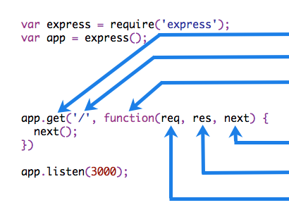
Express.js / Middlewares
express.Router
Middleware functions are functions that have access to the request object (req), the response object (res), and the next function in the application’s request-response cycle. The next function is a function in the Express router which, when invoked, executes the middleware succeeding the current middleware.
Middleware functions can perform the following tasks:
Execute any code.
Make changes to the request and the response objects.
End the request-response cycle.
Call the next middleware in the stack.
If the current middleware function does not end the request-response cycle, it must call next() to pass control to the next middleware function. Otherwise, the request will be left hanging.

Slide 29
Express.js/ running express server
const express = require('express');
const app = express();
const port = 3000;
app.get('/', (req, res) => {
res.send('Hello World!')
});
app.listen(port, () => {
console.log('Example app listening on port ${port}!')
});

Slide 30
Mongoose
We will go through the mongoose documentation quick start guide
https://mongoosejs.com/docs/guide.html

Slide 31
Using Express.js & Mongoose to Build API
Let’s build our API’s for our Bsquare marketplace using express and nodejs
Start express server
Setup middleware
Body-parser (urlencoded({extended:true} , json())
Cors
passport
Connect to mongodb
User
Model , Controller and Route
CRUD , with pagination and sort
Authentication Logic
Protect routes
Roles
Basic, Admin
Product
Model , controller, Route
CRUD, Read with pagination and sort
Cart
Model, controller , Route
Order
Model, controller , Route
CRUD with pagination and sort

Slide 32
USing Express.js to Build API
Npm dependencies
Express
Dotenv
Bcrypt
Body-parser
Jsonwebtoken
mongoose
Accesscontrol
Dev dependencies
nodemon

Slide 33
What is Angular
An open-source framework for building client side applications in HTML , CSS , and JS/TS
Frameworks and libraries like angular , ember , react js make web development easier relative to vanilla js. They make it easier to understand the application and easier to test.
Used to develop Single page Applications

Slide 34
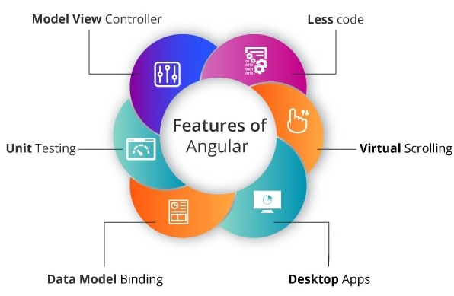
Benefits of Using Angular
Easy DOM manipulation with less code
Uses Model-View-Controller Pattern
Unit testing is easy
Out of the box data model binding
We can easily create desktop apps
Efficient techniques used for the modern web (e.g. virtual scrolling used when loading and unloading items from DOM, only items that are visible are loaded

Slide 35

Angular Apps & SPA
Focused on SPA (Single-Page-Applications) architecture.
A single-page application is an app that works inside a browser and does not require page reloading during use. You are using this type of applications every day. These are, for instance: Gmail, Google Maps, Facebook or GitHub.
Single page application just loads the requested information while for multi-page application the browser reloads and download the whole content of the page again. It is one of the major difference between multipage and single page web apps.

Slide 36
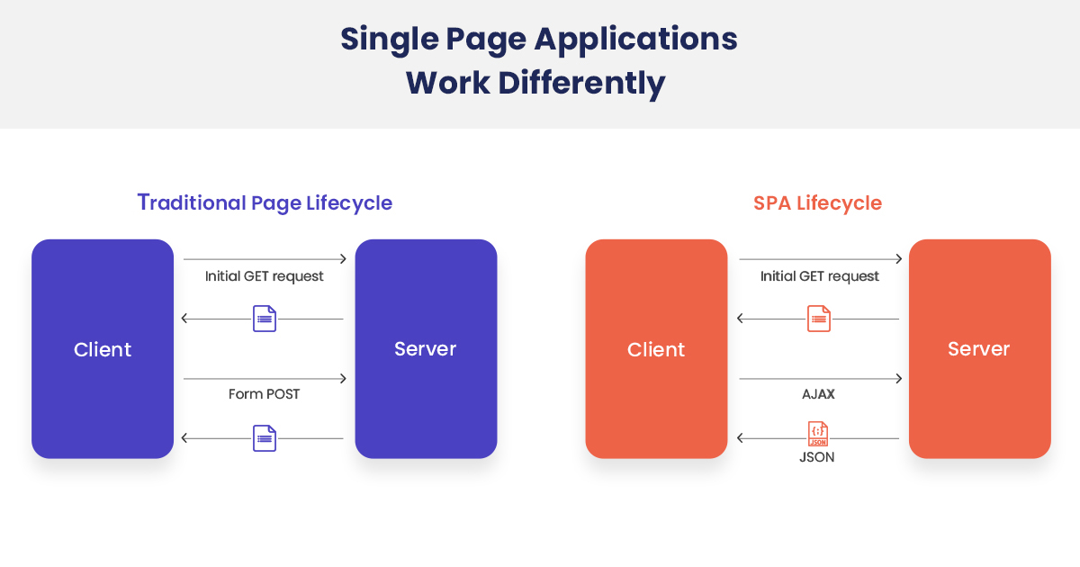
Architecture of Angular Apps

Slide 37
Install Angular
Install Node.js (https://www.guru99.com/download-install-node-js.html)
Install Typescript https://www.typescriptlang.org/download
Install Angular CLI
npm install -g @angular/cli
To check if installation was successful run
ng v
Create a new angular app called simpleApp , in your folder of choice
ng new simpleApp
Run your App
ng serve

Slide 38
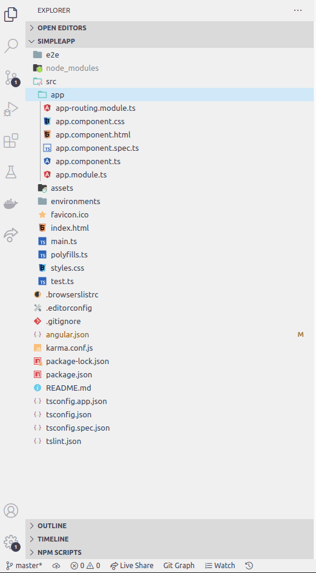
Folder Structure of Angular Apps
App folder: our Application logic / code goes here
Assets : Images and other assets files that will be copied as is to other environments, it won’t be transpiled by webpack
Environments: contains build configuration options for a particular environment (dev, production(prod), staging)
Favicon: is the Favourites Icon used by the browser bookmarks bar.
Index.html: the single file that makes the SPA everything gets injected here by webpack/cli.
Main.ts : Entry point for our Angular App. It bootStraps our by creating an instance of AppModule.
Polyfill.ts : it ensures our app also supports old browsers.
Styles.css: global styles to be applied through out the application
Test.ts :

Slide 39
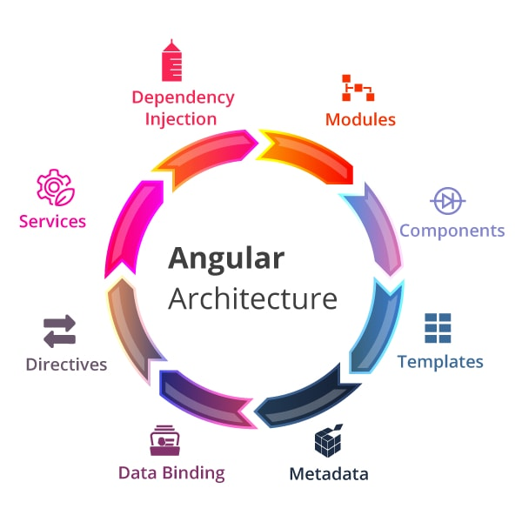
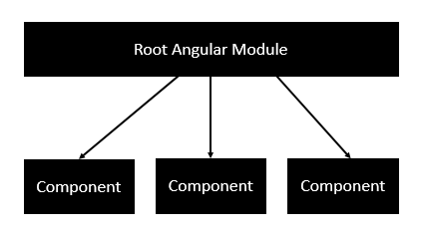
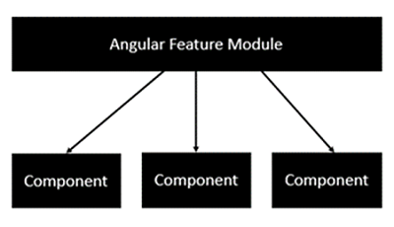
Architecture of Angular Apps
Modules:
Applications built with Angular are modular.
Angular has its own modularity system called NgModules.
Every Application built with angular has at least one NgModule which we call AppModule / the root Module.
It's a way of Organizing related components, services and capabilities by business concern /features
A module has 5 important properties .
Imports | Exports
Providers | Declarations.
Bootstrap

Slide 40
Architecture of Angular Apps
NgModules:
Declarations : The components, directives, and pipes that belong to the NgModule. It is how we connect the component to the NgModule.
Exports: The subset of declarations that should be visible and usable in the component templates of other NgModules.
Imports: Other NgModules whose exported classes are needed by component templates declared in this module.
Providers: Creators of services that this module contributes to the global collection of services; they become accessible in all parts of the app. (You can also specify providers at the component level.)
Bootstrap : The main application component, called the root component, which hosts all other app components. Only the root module should set the bootstrap property.

Slide 41
Architecture of Angular Apps
An example of a Root Module:
import { NgModule } from '@angular/core';
import { BrowserModule } from '@angular/platform-browser';
import { AppComponent } from './app.component';
@NgModule ({
imports: [ BrowserModule ],
declarations: [ AppComponent ],
bootstrap: [ AppComponent ]
})
export class AppModule { }

Slide 42
Architecture of Angular Apps
Frequently-used modules
NgModule | Import it from | Why we use it
BrowserModule | @angular/platform-browser | When you want to run your app in a browser
CommonModule | @angular/common | When you want to use NgIf, NgFor
FormsModule | @angular/forms | When you want to build template driven forms (includes NgModel)
ReactiveFormsModule | @angular/forms | When you want to build reactive forms
RouterModule | @angular/router | When you want to use RouterLink, .forRoot(), and .forChild()
HttpClientModule | @angular/common/http | When you want to talk to a server

Slide 43
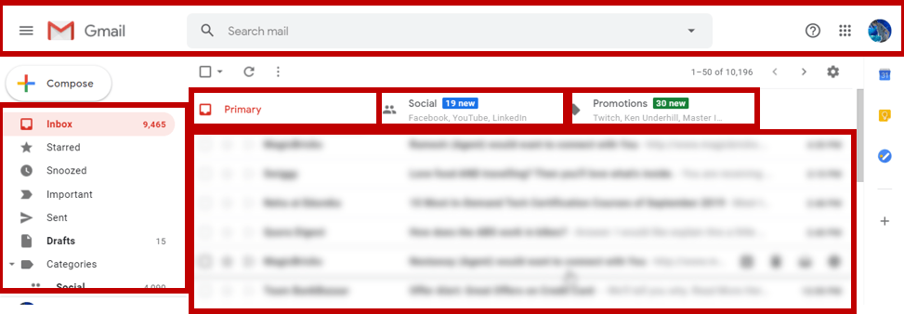
Architecture of Angular Apps
Components:
Building blocks of an angular app. It defines and makes up a patch of the screen called view of our application. Components also control the life cycle of a view
They are classes that designated as components with the help of the component decorator
It encapsulates the
Data (Behaviour + State in TS Class),
HTML Template and
Logic for a view
Every Application has at least one Component called AppComponent or Root Component
A real world Angular application is a tree of components starting from the Root Component.

Slide 44
Architecture of Angular Apps
template: '
<div>
<h1>{{appTitle}}</h1>
</div>
'
Templates:
Templates are HTML chunks that explain to Angular how to render a component, it also alters the HTML based on the components logic and state and DOM data.
Templates are regular HTML with Angular template syntax . template syntax is the way how components communicate back to views and views communicate back to components.
A Component and a template together define a View

Slide 45
Architecture of Angular Apps
Meadata :
Components are defined using Classes and metadata is used to decorate the class and extend the functionality of the class.
It is how we extends normal TS Classes in to Components, We decorate our class with @Componenet decorator
In the example next page :
We are using the import keyword to import the ‘Component’ decorator from the angular/core module.
We are then using the decorator to define a component.
The component has a selector called ‘my-app’. This is nothing but our custom html tag which can be used in our main html page.

Slide 46
Architecture of Angular Apps
Example of a Component
import { Component } from '@angular/core';
@Component ({
selector: 'my-app',
templateUrl: 'app/app.component.html'
})
export class AppComponent {
appTitle: string = 'Welcome';
}
//We are defining a class called AppComponent.
//The export keyword is used so that the component can be used in //other modules in the Angular application.
//appTitle is the name of the property.
//The property is given the type of string.
//The property is given a value of ‘Welcome’.

Slide 47
Architecture of Angular Apps
Data Binding:
components are made using typescript classes and a template.
Classes have behaviour through methods and state through properties and to organize the template part along with the component part, we use data binding,we call it property binding and event binding respectively.
import { Component } from '@angular/core'; @Component ({ selector: 'my-app', templateUrl: 'app/app.component.html' }) export class AppComponent { Title: string = 'Welcome'; DataList: any[] = [ { "ID": "1", "url": 'app/Images/One.jpg' }, { "ID": "2", "url": 'app/Images/Two.jpg' } ]; } | <div *ngFor = 'let lst of DataList'> <ul> <li>{{lst.ID}}</li> <img src=”{{list.url}}”> <img [src] = 'lst.url'> <img bind-src=”list.url”> </ul> </div>

Slide 48
Architecture of Angular Apps
Directives :
Templates are always dynamic, and to achieve this we use directive.
Two types of directives Attribute Directives & Structural Directives.
Structural directives replace , add , remove elements in a DOM .
Attribute Directives modify behavior or appearance of an existing element in a DOM.

Slide 49
Architecture of Angular Apps
Services and DI:
For data or logic that isn't associated with a specific view, and that we want to share across components, we create a service class.
This kind of logics can be fetching data from server , validating user input , share data among multiple components, application logic like calculating sum ,
A service class definition is immediately preceded by the @Injectable() decorator. The decorator provides the metadata that allows other providers to be injected as dependencies into your class.
Dependency injection (DI) lets us keep our component classes lean and efficient and testable.

Slide 50
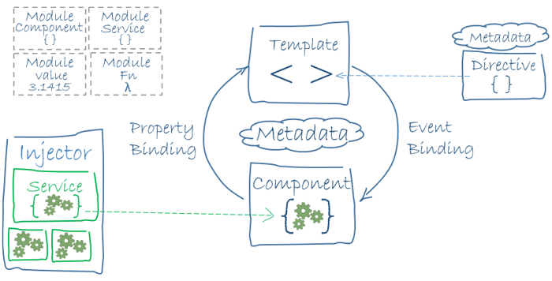
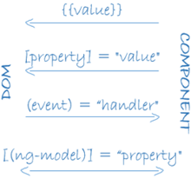
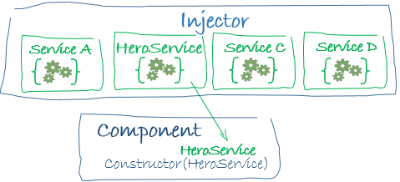
Architecture of Angular Apps

Slide 51
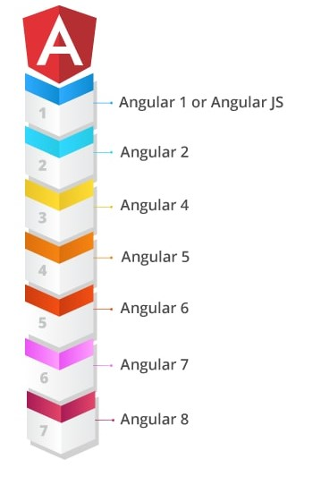
Different Angular Versions
Angular 1: referred to as Angular.js, JS Based , MVC
Angular 2: built with mobile in mind, complete rewrite , you can use TS , ES5, ES6,Dart to develop.
Angular 3: skipped due to mismatch between @angular/router which was already in V3 and other angular core libraries which were in v 2. Releasing Angular 3 with its router in 4 would create a confusion so angular was also release as v4.
Angular 4: backward compatible to v2 , reduce the generated code for components by 60%, faster compilation. Animations pulled out of @angular/core, introduction of *ngIf/else, TS 2.2 compatibility
Angular 5: better internationalization support , @angular/http deprecated in place of @angular/common/http, new Router life cycle events: GuardsCheckStart, ChildActivationStart, ActivationStart, GuardsCheckEnd, ResolveStart, ResolveEnd, ActivationEnd, ChildActivationEnd
Angular 10 : TS 3.9 , warning about common js imporst
For more referee to
https://www.ngdevelop.tech/angular/history/

Slide 52
Creating Components
git checkout simple_app_component_starter
git checkout simple_app_component_finished
Manually :
Create a component named courses
Add File courses.component.ts
Create class CoursesComponent and export it.
Decorate CoursesComponent class with @component decorator by importing it from @angular/core
Provide our decorator with selector <courses>,
Provide our decorator with template option
Register our component in our appModule NgModule
Add it to our declarations array.
Add an element representing our component in our HTML markup
Inside app.componenet.html use the selector we defined <courses></courses>
File naming convention : courses.component.ts if the name of the file is multi word courses-detail.component.ts
Class naming convention: Pascal naming convention : CoursesComponent
Component Decorator options :
Selector : representation of our component in the template view
To use a selector like <courses> set selector option “courses”
To use a selector like <div class=”courses> set selector option “.course”
To use a selector like <div id=”course”> set selector option “#course”
Template: An inline template for an Angular component.

Slide 53
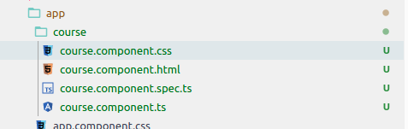

Creating Components
Angular CLI :
Inside the simpleApp root folder run
ng generate component course OR ng g c course
It will automatically wire up the 3 steps. If you open and see app.module.ts it has also wired it up automatically
Going forward we will use angular CLI to generate components

Slide 54
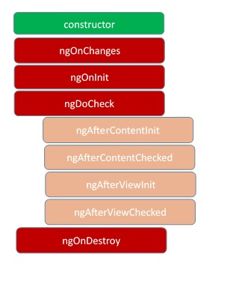
A Components LifeCycle
A component instance has a lifecycle that starts when Angular instantiates the component class and renders the component view along with its child views.
The lifecycle continues with change detection, as Angular checks to see when data-bound properties change, and updates both the view and the component instance as needed.
The lifecycle ends when Angular destroys the component instance and removes its rendered template from the DOM.
Directives have a similar lifecycle, as Angular creates, updates, and destroys instances in the course of execution.

Slide 55
A Components LifeCycle
Life cycle method | Description | Timing
ngOnChanges | Respond when Angular sets or resets data-bound input properties. The method receives a SimpleChanges object of current and previous property values. | Called before ngOnInit() and whenever one or more data-bound input properties change. Note that if your component has no inputs or you use it without providing any inputs, the framework will not call ngOnChanges().
OnInit | Initialize the directive or component after Angular first displays the data-bound properties and sets the directive or component's input properties. | Called once, after the first ngOnChanges().
ngDoCheck | Detect and act upon changes that Angular can't or won't detect on its own | Called immediately after ngOnChanges() on every change detection run, and immediately after ngOnInit() on the first run.
ngOnDestroy | Cleanup just before Angular destroys the directive or component. Unsubscribe Observables and detach event handlers to avoid memory leaks. | Called immediately before Angular destroys the directive or component.

Slide 56
View Encapsulation
In Angular, component CSS styles are encapsulated into the component's view and don't affect the rest of the application.
To control how this encapsulation happens on a per component basis, you can set the view encapsulation mode in the component metadata. Choose from the following modes:
ShadowDom view encapsulation uses the browser's native shadow DOM implementation to attach a shadow DOM to the component's host element, and then puts the component view inside that shadow DOM. The component's styles are included within the shadow DOM.
Emulated view encapsulation (the default) emulates the behavior of shadow DOM by preprocessing (and renaming) the CSS code to effectively scope the CSS to the component's view.
None means that Angular does no view encapsulation. Angular adds the CSS to the global styles. The scoping rules, isolations, and protections discussed earlier don't apply. This is essentially the same as pasting the component's styles into the HTML.

Slide 57
Expressions & templates
Interpolation and Template expressions example
Expression context: A template has access to the instance of the component that manages it and the instance of the component available in the template is called expression context.
Template expression : interpolation with {{...}}
Angular evaluates the template expression between the braces first and then converts it to string
Template expression should be simple,
a property name or a method call or a boolean negation
Quick Execution
Angular executes template expressions after every change detection cycle. Change detection cycles are triggered by many asynchronous activities such as promise resolutions, HTTP results, timer events, key presses and mouse moves. Expressions should finish quickly or the user experience may drag, especially on slower devices. Consider caching values when their computation is expensive.
A template expression should not change any application state other than the value of the target property.
You can't use JavaScript expressions that have or promote side effects, including:
Assignments (=, +=, -=, ...)
Operators such as new, typeof, instanceof, etc.
Chaining expressions with ; or ,
The increment and decrement operators ++ and --

Slide 58
Transforming Data
Pipes example
Pipes : helps us transform data before displaying them in HTML pages. E.g. formatting currencies, formatting numbers, uppercase text, lowercase text or title case text etc..
Pipes are simple functions you can use in template expressions to accept an input value and return a transformed value.
Angular provides built-in pipes for typical data transformations, including transformations for internationalization (i18n), which use locale information to format data. The following are commonly used built-in pipes for data formatting:
DatePipe: Formats a date value according to locale rules.
UpperCasePipe: Transforms text to all upper case.
LowerCasePipe: Transforms text to all lower case.
CurrencyPipe: Transforms a number to a currency string, formatted according to locale rules.
DecimalPipe: Transforms a number into a string with a decimal point, formatted according to locale rules.
PercentPipe: Transforms a number to a percentage string, formatted according to locale rules
We can also create custom pipes to transform data as we see fit.
Create a class that implements PipeTransform interface
To create a custom pipe decorate a class with @Pipe
Register our custom pipe with with ngModule as declarations
Angular invokes the transform method with the value of a binding as the first argument, and any parameters as the second argument in list form, and returns the transformed value.

Slide 59
Transforming Data
Pipes example
Pipes :
Pure Pipes (default)
Impure Pipes (expensive as it is run on every change even when the source data is not changed, can run uncessarly)
Pure Pipes are executed when a pure change to the input value is detected
A pure change is
In case of a primitive type (string,Number, Boolean) when the value changes.
In case of reference types (Array,Date,Object) when the object reference is changed.
A pure pipe is NOT EXECUTED if the input to the pipe is an object and only the property values of the object change but not the reference.
Impure Pipes are executed when an Impure change to the input value is detected, such as a change to an element of an array, Angular executes an impure pipe every time it detects a change with every keystroke or mouse movement.
Impure Change makes sense in the case of reference types
For a reference types (Array,Date,Object) when the object fields change .e.g arra.push() , object.field = ‘xyz’
To make a pipe impure set the pure option to false
@Pipe({
name: 'flyingHeroesImpure',
pure: false
})

Slide 60
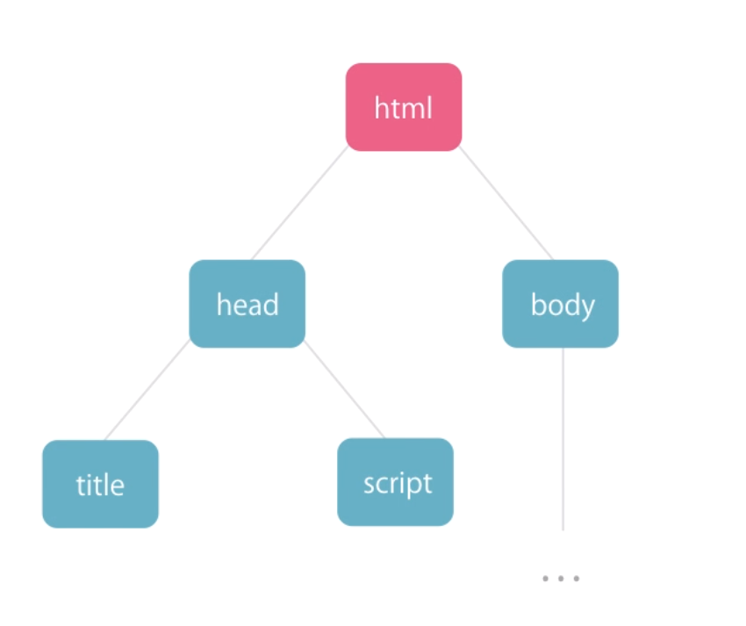
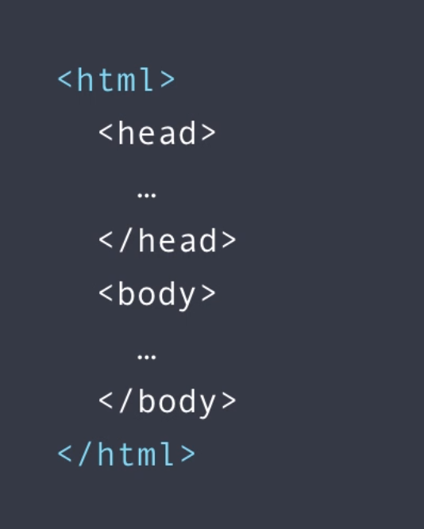
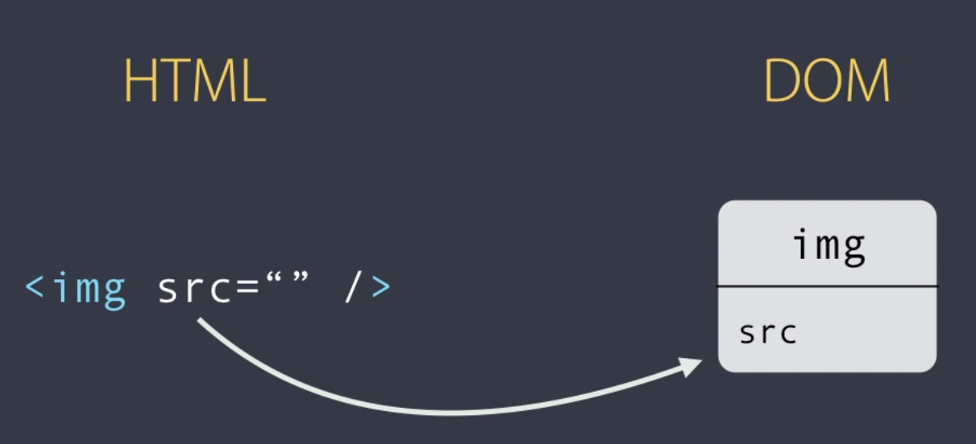
HTML VS DOM
DOM vs HTML:
HTML: A web page document representation
DOM: is an object oriented representation of the HTML elements as nodes and objects., which can be modified with javascript
Most HTML element attributes have a one to one mapping to properties of DOM object
E,g images src attribute is also a property of the img DOM object.
<img src="" />
But there are exceptions
E.g.
colspan attribute of <td> doesn't have a property match in its DOM equivalent
A Property in DOM textContent doesn’t have representation in HTML elements attributes to.

Slide 61
Binding
Type | Syntax | Category
Interpolation Property Attribute Class Style | { { expression } } [target] = "expression" bind-target="expression" | One-way from data source to view target
Event | (target) = "statement" on-target="statement" | One-way from view target to data source
Two-way | [(target)] = "expression" bindon-target="expression" | Two-way
The target of a data-binding is something in the DOM. Depending on the binding type, the target can be :
a property (element, component, or directive),
an event (element, component, or directive), or
attribute name

Slide 62
Property Binding
Property Binding Example
Helps us set values for properties , attributes of HTML DOM elements or directive.
Property binding flows data in one direction component property -> target element property in the template
To bind to an elements property we use [ ], which identifies the property as a target property. A target property is the DOM property to which we want to assign a value. The brackets, [], cause Angular to evaluate the right-hand side of the assignment as a dynamic expression. Without the brackets, Angular treats the the right-hand side as a string literal and sets the property to that static value.
<img class="img-thumbnail float-right rounded" src={{url}} />
<img class="img-thumbnail float-right rounded" [src]='url' height="200” width="200" />
<h2>{{title}}</h2>
<h2 [textContent]="title"></h2>

Slide 63
Attribute , Class & Style Binding
Attribute & Style Binding Example
Attribute binding syntax :
<p [attr.attribute-you-are-targeting]="expression"></p>
Class binding:
We use it to dynamically control the class assigned to an element.
<tr class="row”
[class.tableSuccess]="coursesTaken[2].completed"
[class.rowError] = "coursesTaken[1].error">
</tr>
Style Binding:
We use style binding to dynamically set a style property
<th [style.display]="logoColVisible" class="float-right">logo</th>

Slide 64
Event Binding & Filtering
Event Binding Example
Event Binding : Event binding allows you to listen for and respond to user actions such as keystrokes, mouse movements, clicks, and touches. To handle to HTML events we use what are called template statements
<button (click)="toggleFavoriteForCourse(coursesTaken[0])”></button>
Event Bubbling :
All dom events bubble up the DOM tree unless a handler prevents further bubbling , which is a standard event propagation mechanism in DOM.
To stop event bubbling we can use $event.stopPropagation()
Event Filtering : a type of event handling where we filter the event we want.
Keyup :
<input #box
(keyup.enter)="update(box.value)"
(blur)="update(box.value)" />

Slide 65
Two-way Data Binding
Two-Way Binding Example
Two Data Binding:
Object oriented way of doing things instead of template variables
Propagates changes from our templates to our component
Uses banana-in-a-box syntax [()]
Uses [(ngModel)] which is a directive we use to manipulate the DOM. it is not an element property
<input [value]="email" (keyup.enter)="email = $event.target.value; onKeyUp()"/>
<input [(ngModel)] = "email" />
To use ngModel make sure to import FormsModule from @angular/forms in app.module.ts
import { FormsModule } from '@angular/forms';
imports: [
BrowserModule,
FormsModule
],

Slide 66
Binding Summary
Type | Target | Eg.
Property | Element property Component property Directive property | src, hero, and ngClass in the following: <img [src]="heroImageUrl"> <app-hero-detail [hero]="currentHero"></app-hero-detail> <div [ngClass]="{'special': isSpecial}"></div>
Event | Element event Component event Directive event | click, deleteRequest, and myClick in the following: <button (click)="onSave()">Save</button> <app-hero-detail (deleteRequest)="deleteHero()"></app-hero-detail> <div (myClick)="clicked=$event" clickable>click me</div>
Two-way | Event and property | <input [(ngModel)]="name">
Attribute | Attribute | <button [attr.aria-label]="help">help</button>
Class | class property | <div [class.special]="isSpecial">Special</div>
Style | Style property | button [style.color]="isSpecial ? 'red' : 'green'">

Slide 67
Template variables
template variables example
Template variables are a way to reference to our elements in our template.
A template variable can refer to the following:
a DOM element within a template
a directive
an element
TemplateRef
A web component
Angular assigns a template variable a value based on where you declare the variable:
If you declare the variable on a component, the variable refers to the component instance.
If you declare the variable on a standard HTML tag, the variable refers to the element.
If you declare the variable on an <ng-template> element, the variable refers to a TemplateRef instance, which represents the template.
If the variable specifies a name on the right-hand side, such as #var="ngModel", the variable refers to the directive or component on the element with a matching exportAs name.

Slide 68
Passing data and event between our Components & Template
template variables example
Scope:
You can refer to a template variable anywhere within its surrounding template. Structural directives, such as *ngIf and *ngFor, or <ng-template> act as a template boundary. You cannot access template variables outside of these boundaries.
An inner template can access template variables that the outer template defines.

Slide 69
Template expression Operators
template expression Operators example
Pipe (|):
the result of an expression might require some transformation before you’re ready to use it in a binding
Simple functions that accept an input value and return a transformed value
Safe navigation Operator (?) :
guards against null and undefined values in property paths
<p>The item name is: {{item?.name}}</p>
Non-null assertion Operator (!) :
Enforces strict null checking, so that no variable is unintentionally null or undefined.
<!-- Assert color is defined, even if according to the `Item` type it could be undefined. -->
<p>The item's color is: {{item.color!.toUpperCase()}}</p>
The $any() type cast function :
Sometimes a binding expression triggers a type error during AOT compilation and it is not possible or difficult to fully specify the type. To silence the error, you can use the $any() cast function to cast the expression to the any type as in the following example:
<p>The item's undeclared best by date is: {{$any(item).bestByDate}}</p>

Slide 70
Directives
Directives
Built in Directives
Structural Directive : Modify DOM elements, by adding, removing and manipulating the host elements.
We use * when using structural directives e.g.
*ngif : conditionally creates or destroys subviews from the template.
*ngfor: repeat a node for each item in a list.
*ngSwithCase: a set of directives that switch among alternative views.
Attribute Directive : Modify attributes of existing DOM elements and changes the appearance or behavior of a DOM element.
ngClass : adds and removes a set of CSS classes.
ngStyle : adds and removes a set of HTML styles.
ngModel : adds two-way data binding to an HTML form element
Custom Directives
Structural Directive
Attribute Directive
Components : directives with templates

Slide 71
Built In Directives
Built in Directives example
*ngIf : show or hide a component based on the if case (Truthy or Falsy Condition)
<!-- option 1 --> <div *ngIf="courses.length > 0"> Courses List </div> <div ngIf="courses.length == 0"> No Courses Yet </div> | <!-- Option 2 --> <div *ngIf="courses.length > 0; noCourses"> </div> <ng-template #noCourses> No courses yet </ng-template> | <!-- Option 3 --> <div *ngIf="courses.length > 0; then coursesList else noCourseList"></div> <ng-template #coursesList> Courses List </ng-template> <ng-template #noCourseList> No Courses Yet </ng-template>

Slide 72
Built In Directives
Built in Directives example
*ngSwithCase: just like switch case statements ; used when we have multiple cases.
<div [ngSwitch]="viewMode">
<div *ngSwitchCase="'list'">list view</div>
<div *ngSwitchCase="'grid'">grid view</div>
<div *ngSwitchDefault></div>
</div>

Slide 73
Built In Directives
Built in Directives example
*ngFor: used to display a list of items,
It exports values that can help us with list items (https://angular.io/api/common/NgForOf#local-variables)
Index : The index of the current item in the iterable.
count: number: The length of the iterable.
first: boolean: True when the item is the first item in the iterable.
last: boolean: True when the item is the last item in the iterable.
even: boolean: True when the item has an even index in the iterable.
odd: boolean: True when the item has an odd index in the iterable.
We use trackBy with ngFor to track elements of the iterable object ; by default the change detector of ngFor assumes that the object instance identifies the node in the iterable, when trackBy is provided the directive uses the result of calling this function to identify the item node, rather than the identity of the object itself.

Slide 74
Built In Directives
Built in Directives example
* the leading asterisk
Angular translates the *ngIf attribute into a <ng-template> element, wrapped around the host element, like this.
<div *ngIf="coursesTaken.length > 0; else noCourses"> List of Courses </div> <ng-template #noCourses> No Courses </ng-template> <div *ngFor="let hero of heroes; let i=index; let odd=odd; trackBy: trackById" [class.odd]="odd"> ({{i}}) {{hero.name}} </div> | <ng-template [ngIf]="courses.length > 0"> List of Courses </ng-template> <ng-template [ngIf]="!(courses.length > 0)"> No Courses </ng-template> <ng-template ngFor let-hero [ngForOf]="heroes" let-i="index" let-odd="odd" [ngForTrackBy]="trackById"> <div [class.odd]="odd">({{i}}) {{hero.name}}</div> </ng-template>

Slide 75
Built In Directives
The <ng-template>
The <ng-template> is an Angular element for rendering HTML. It is never displayed directly. In fact, before rendering the view, Angular replaces the <ng-template> and its contents with a comment.
The <ng-container>
is a grouping element that doesn't interfere with styles or layout because Angular doesn't put it in the DOM.
<p> I turned the corner <span *ngIf="hero"> and saw {{hero.name}}. I waved </span> and continued on my way. </p> | <p> I turned the corner <ng-container *ngIf="hero"> and saw {{hero.name}}. I waved </ng-container> and continued on my way. </p>
p span { color: red; font-size: 70%; }

Slide 76
Custom Directives
custom Attribute directives example
Attribute Directives :
Steps to creating a custom attribute directives :
A class annotated with @Directive which specifies the selector that identifies the attribute
import { Directive } from '@angular/core';
@Directive({
selector: '[appHighlight]'
})
export class HighlightDirective {
constructor(el: ElementRef) {
el.nativeElement.style.backgroundColor = 'yellow';
}
}
It's the brackets ([]) that make it an attribute selector.
Angular locates each element in the template that has an attribute named appHighlight and applies the logic of this directive to that element.
It is best practice to prefix selector names to ensure they don’t conflict with standard HTML attributes.

Slide 77
Custom Directives
Attribute Directives :
Steps to creating a custom attribute directives :
1.we use the ElementRef in the directive's constructor to inject a reference to the host DOM element, the element to which you applied appHighlight.
ElementRef grants direct access to the host DOM element through its nativeElement property.
2. Apply the directive to the element you want.
<p [appHighlight]>Highlight me!</p>

Slide 78
Custom Directives
Structural directives example
Structural Directives :
Steps to creating structural directives
Import the Directive decorator
Import the Input, TemplateRef, and ViewContainerRef symbols; you'll need them for any structural directive.
Apply the decorator to the directive class.
Set the CSS attribute selector that identifies the directive when applied to an element in a template.
import { Directive, Input, TemplateRef, ViewContainerRef } from '@angular/core';
@Directive({ selector: '[appCustomFormat]'})
export class customDirective {
}
Inject TemplateRef and ViewContainerRef in the directive constructor as private variables of the class
constructor(private templateRef: TemplateRef<any>,private viewContainer: ViewContainerRef) { }
PLease refer to the example for full detail

Slide 79
FORMS
We use forms to handle user inputs and user interactions (login , update profile , ..)
Forms provide a way
Capture use input events from the view
Validate user input
Create a form model
Provide a data model to update and track changes.
Angular provides two ways of handling user input through forms
Template Driven :
We use directives in the template to create and manipulate the underlying object model. They are useful for adding a simple form to an app, such as an email list signup form. They're easy to add to an app, but they don't scale as well as reactive forms. If you have very basic form requirements and logic that can be managed solely in the template, template-driven forms could be a good fit.
Reactive-forms / Model driven Forms :
provide direct, explicit access to the underlying forms object model. Compared to template-driven forms, they are more robust: they're more scalable, reusable, and testable. If forms are a key part of your application, or you're already using reactive patterns for building your application, use reactive forms.

Slide 80
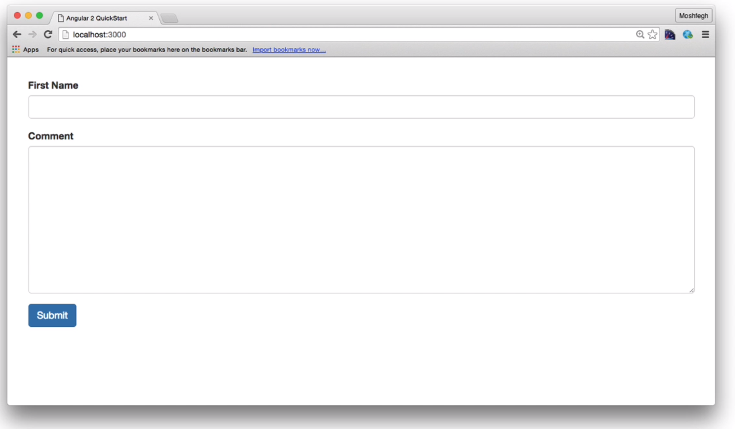
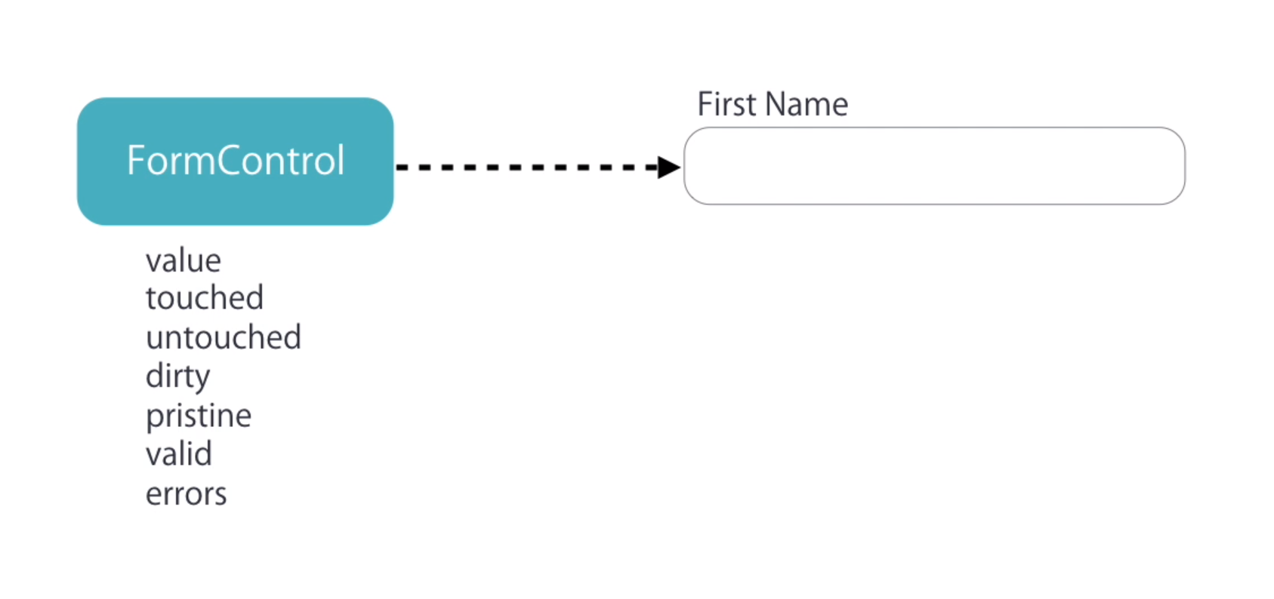
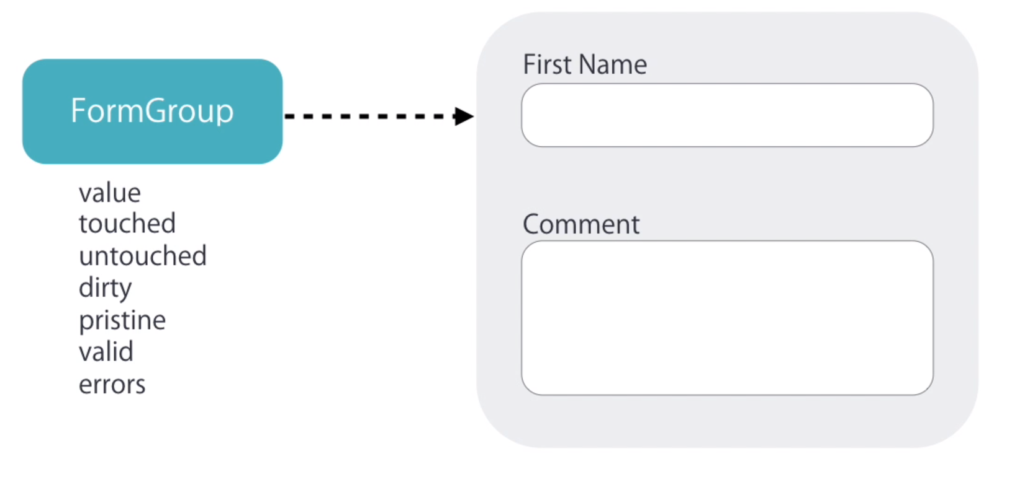
FORMS
For each input element in our angular creates a formControl
Each form is a FormGroup/controlGroup (a group of controls in a form)

Slide 81
Reactive vs Template forms
 | Reactive | Template-driven
Setup of form model | Explicit, created in component class. We have more control over validation logic | Implicit, created by directives
Data model | Structured and immutable | Unstructured and mutable
predictability | Synchronous | Asynchronous
Form validation | Functions | Directives

Slide 82
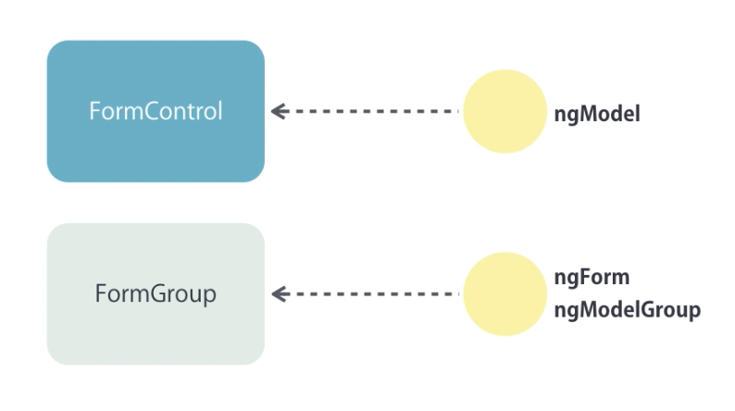
Template Driven Forms
Input Elements
uses ngModel to bend an input element to a form control
To access the ngModel of an element we can use a template variable
HTML5 Validation for product name
Required
Min length and min length
Pattern name should be number and characters
ngForm:
Angular by default applies ngForm directive to a form element in HTML.
To get a reference to thes ngForm directive we can create a template variable.
It has an output property ngSubmit which we can use to raise an event.
ngForm includes all the validation properties we so earlier, other than that we have the formGroup property which represents a group of form fields
ngForm has a property value which we can use to easily get the data from the form
ngModelGroup
To represent complex objects in forms, that need to be represented as a unit in forms.
E,g, contact : firstName , last Name,
Address: shipping , building,

Slide 83
Template Driven Forms
Exercise :
ngModelGroup
Using ngModelGroups define the products specs:
Difficulty using drop down
Prerequisites using multi select drop downs or checkboxes
Disable the submit button : if form is invalid

Slide 84
Services
Components focus on Data presenting and delegate data access to a service.
Services are a great way to share information among classes that don't know each other.
Services are injectable. The @Injectable decorator marks the class as one that participates in the dependency injection system.
To generate a service run
ng generate service course
To use a service in components we inject the service in the constructor method
constructor(private courseService: CourseService) {}
E.g
create a method showCurrentDate that returns currentDate in courseService
Use the courseService.showCurrentDate() in your app component to show the current date.
Services can be injected in to components and also other services
If you one service depends on another service make sure the services are registered as a provider inside you module.

Slide 85
Services
Exercise :
In our product Service create the following methods
getCourses()
Send array of courses
createCourse(course: ICourse)
Push to an array a course passed
toggleFavorite(courseId: string)

Slide 86
Consuming HTTP (sending/receiving data from server)
In the component/service you want to fetch data from inject Http inside the constructor
constructor(private http: HttpClient) { }
Import HttpModule in AppMOdule
import { HttpClientModule } from '@angular/common/http';
In App.module.ts
import { HttpClientModule } from '@angular/common/http';
@NgModule({
imports: [
BrowserModule,
// import HttpClientModule after BrowserModule.
HttpClientModule,
],
declarations: [
AppComponent,
],
bootstrap: [ AppComponent ]
})
export class AppModule {}

Slide 87
Consuming HTTP (sending/receiving data from server)
In the component/service you want to fetch data from inject HttpClient inside the constructor
constructor(private http: HttpClient) { }
getTodos() {
return this.http.get<Todo[]>(this.url_todo, { observe: 'body', responseType: 'json' });
}
createToDos(todo: Todo) {
return this.http.post<Todo>(this.url_todo, todo);
}
toggleCompleted(id: number, completed) {
return this.http.patch(this.url_todo + `/${id}`, { completed })
}
deleteToDo(id: number) {
return this.http.delete(this.url_todo + `/${id}`);
}

Slide 88
Consuming HTTP (sending/receiving data from server)
Points to Remember
Do not call http methods in constructor instead use ngOnInit
Use services as a separation of concern to handler api requests
Use http.get for fetching resource
Http.post for creating resource
Http.patch for updating by specific field
Http.put to update the whole resource
Http.delete to delete a resource

Slide 89
Consuming HTTP (sending/receiving data from server)
HttpGet method takes the following options.
options: {
headers?: HttpHeaders | {[header: string]: string | string[]},
observe?: 'body' | 'events' | 'response',
params?: HttpParams|{[param: string]: string | string[]},
reportProgress?: boolean,
responseType?: 'arraybuffer'|'blob'|'json'|'text',
withCredentials?: boolean,
}
Important options include the observe and responseType properties.
The observe option specifies how much of the response to return.
The responseType option specifies the format in which to return data.

Slide 90
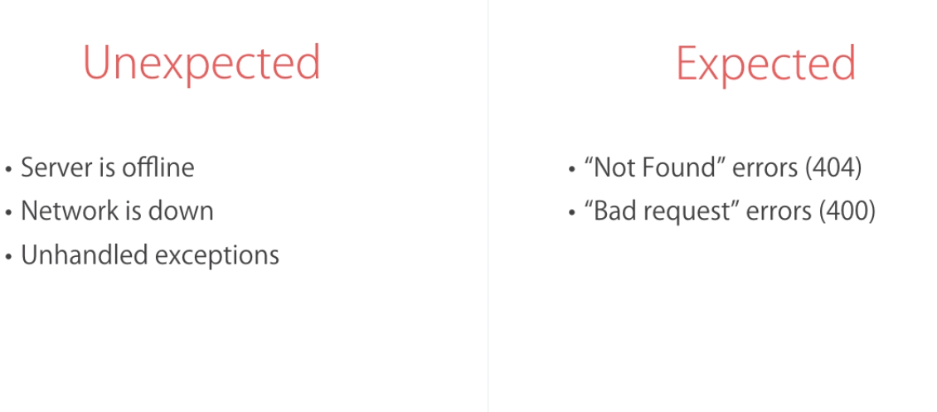
HttpService and Errors

Slide 91
Handling Unexpected Http Errors
Handling UnExpected Errors
this.todoService.getTodos()
.subscribe((response) => {
this.todos = response;
}, (err) => {
alert('An unexpected error occurs');
});
this.todoService.toggleCompleted(todo.id, todo.completed)
.subscribe((response) => {
console.log(response);
},
(err) => {
alert('An unexpected error occurs');
})

Slide 92
Handling expected Http Errors
deleteTodo(id: number): void {
this.todoService.deleteToDo(id).subscribe((response) => {
this.todos = this.todos.filter(todo => todo.id !== id);
}, (error: Response) => {
if (error.status === 404)
alert("This item has already been deleted");
else {
alert("An unexpected error occurred");
}
})
}

Slide 93
Handling expected Http Errors
deleteTodo(id: number): void {
this.todoService.deleteToDo(id).subscribe((response) => {
this.todos = this.todos.filter(todo => todo.id !== id);
}, (error: Response) => {
if (error.status === 404)
alert("This item has already been deleted");
else {
alert("An unexpected error occurred");
}
})
}

Slide 94
Handling Http Erors
`To read : please cover Angular HttpInterceptors topic and how to handle errors on your own
https://pusher.com/tutorials/error-handling-angular-part-2

Slide 95
Routing and Navigation
Please refer to navigation component
Helps us with navigation with in our application
A route is a mapping of a path to a component
Steps involved in defining a Route
Configure Route
Add a Router Outlet
Add links
Configuring Routes :
Root Route is home
/forms -> forms component
/product -> ProductComponent
/product/1 -> ProductDetailComponent
/forms -> TformsComponent
/http-todo -> TodoComponent
** -> anything else goes to NotFound

Slide 96
Routing and Navigation
Step 1: Import Router module from @angular/router
import { RouterModule } from '@angular/router';
Step 2 : Import Router module in your Root Module or Define a Route Module.
RouterModule.forRoot()
For root is a static method defined in our RouterModule class.
We use ForRoot to define the root routes for our application
We can have routes defined across modules and in such cases we can use RouterModule.forChild()
Inside forRoot we pass an array of Objects:
Path: to be displayed
Component: the component.
RouterModule.forRoot([
{ path: '', component: HomeComponent },
{ path: '/product', component: ProductComponent },
{ path: '/product/:id', component: ProductDetailComponent },
{ path: '**', component: NotfoundComponent }
])
Order of Routes is Important just like express

Slide 97
Router Outlets
We are getting an error now Can not find primary outlet to load home component
In side app.html define a <router-outlet></router-outlet> element
It is a directive defined in angular/router module
When angular sees this it renders the component associated with the current route after this router-outlet element. It wont render it inside this element

Slide 98
Adding Links
We don’t use href inside links in angular.
If we use the href it will redownload the js it will reload the page
When we click a link we want to show the the new component and the data that is required with it not load everything
We will use a directive called routerLink which is defined also in the router module
Please check the network tab in your browser if any resources where re-downloaded.
Css ,js files (all this were downloaded the first time).
To bind routerLink dynamically you can use property binding syntax with array on the right side
The first element of the array is the path
The subsequent values route arguments
<a class="nav-link" [routerLink]="['/product',product.id]">Products</a>

Slide 99
Active Links
The Home link is always active how do we fix it ? when we are on product page we want product to be active
To do that we use another directive called
routerLinkActive
As a value it takes a list of css classes we should apply when it is active.
<a class="nav-link" routerLinkActive="active" [routerLink]="['/product','id']">Products</a>

Slide 100
Accessing Route parameters from Components
In order to get access to router parameters inside our component we need to inject the ActivatedRoute class inside our constructor.
import { ActivatedRoute } from '@angular/router';
In our ngOnInit we can get our router parameters using
this.route.paramMap
It is of type Observable, so to access it we can use the subscribe method
ngOnInit() {
this.route.paramMap.subscribe((params) => {
console.log(params);
console.log(params.get('id'));
//params.keys //all the keys in our params
//params.getAll(); // the value of all route parameters
//params.get(); //get value a given route parameters
//params.has(); //check to see if we have a parameter with the given name
})
}

Slide 101
Routes with parameters
When defining routes we can define them to be with parameters
//app.module.ts (route definition)
{ path: 'product/:category/:id', component: ProductDetailComponent },
// link definition
<a class="nav-link" [routerLink]="['product','home-lighting','18']">Product Detail(multi param)</a>

Slide 102
Routes with Query Parameters
Query parameters are also known as optional parameters as they are not required to load a page
We dont need to modify our Routing definition rather we add them on our links
<a [queryParams]="{page:1,order:'newest'}" [routerLink]="['product']">Product save</a>
To get our query parmaeters inside our components we first inject ActivatedRoute to our constructor and then in our ngOnInit get the query params
ngOnInit() {
this.route.queryParamMap.subscribe((params) => {
console.log(params)
console.log(params.get('name'))
})
}

Slide 103
Programmatic navigations
If we want to programmatically navigate from our components
Inject Route to our component
goToList() {
// navigate with route params
//this.router.navigate(['/product',1,2,3])
//navigate with query params
this.router.navigate(['/product'],
{ queryParams: { page: 2, order: 'newest' } }
)
}

